Slide 1

DASC 5303 – 001 Project Management
Final Project Topic: Neural Network
Project: Road Accident detection and alert systems
GROUP 4
Patrick Hennecke
Chinmayee Makaraju
Sanjana Shivakumar
Ramya Madhunika Vatsavai
Sai Krishna Bezawada
Point of Contact: pwh8492@mavs.uta.edu

Slide 2
Topic Analysis History
Origins in Biological Inspiration (1940s-1950s): Neural networks draw inspiration from the human brain. The concept originated in the 1940s with the work of Warren McCulloch and Walter Pitts, who proposed a mathematical model of a simplified neuron. This laid the foundation for artificial neural networks.
Perceptron and Early Development (1950s-1960s): In the late 1950s, Frank Rosenblatt introduced the perceptron, a type of artificial neuron capable of learning.
Connectionism and Backpropagation (1980s-1990s): The resurgence of interest in neural networks occurred in the 1980s, marked by the development of the backpropagation algorithm.
Deep Learning Revolution (2000s-Present): The 2000s witnessed a transformative phase in neural networks with the advent of deep learning

Slide 3
Purpose
Pattern Recognition and Classification: One of the primary purposes of neural networks is pattern recognition and classification. Neural networks excel at learning complex patterns and relationships within data.
Machine Learning and Predictive Modelling: Neural networks play a crucial role in machine learning and predictive modelling. They are used to model and learn from data, making predictions and decisions based on the patterns they have discovered.
Natural Language Processing (NLP) and Language Understanding: Neural networks are instrumental in advancing natural language processing tasks. They can comprehend and generate human-like language, facilitating applications such as language translation, sentiment analysis, chatbots, and text summarization
Autonomous Systems and Control: Neural networks are employed in autonomous systems for control and decision-making. In fields like robotics and autonomous vehicles, neural networks process sensor data to make real-time decisions.

Slide 4
Description/What is it?
Fundamental Building Blocks: Neural networks are computational models inspired by the structure and functioning of the human brain. They consist of interconnected nodes, often referred to as neurons or units, organized in layers.
Learning from Data: Neural networks are designed to learn from data through a process called training. During training, the network receives input data, processes it through its layers, and adjusts the weights of connections to minimize the difference between its predicted output and the actual output..
Activation Functions for Non-linearity: Activation functions play a crucial role in neural networks by introducing non-linearities into the model. Each neuron applies an activation function to the weighted sum of its inputs, introducing non-linear transformations that enable the network to capture complex relationships in the data.
Diverse Architectures for Specialized Tasks: Neural networks come in various architectures tailored for specific tasks. For example, convolutional neural networks (CNNs) are effective in image and video analysis, recurrent neural networks (RNNs) are well-suited for sequence data like time series or natural language, and transformers excel in tasks involving attention mechanisms, such as natural language processing

Slide 5
Associated Methods
Activation Functions: Introduce non-linearities to enable neural networks to model complex relationships in data.
Batch Normalization: Normalizes layer inputs for faster training and mitigates issues like internal covariate shift.
Dropout: Prevents overfitting by randomly excluding neurons during training, enhancing model generalization.
Weight Initialization Techniques: Ensure proper initial weights to facilitate efficient training and avoid vanishing/exploding gradients.
Optimization Algorithms: Govern the update of model weights during training, with variations like SGD, Adam, and RMSprop.
Learning Rate Schedulers: Adjust learning rates during training stages to optimize convergence and prevent overshooting.
Data Augmentation: Enhances model robustness by generating new training samples through various transformations of existing data.
Transfer Learning: Utilizes pre-trained models, fine-tuning them for related tasks, particularly useful with limited labelled data.
Early Stopping: Halts training when performance on a validation set begins to degrade, preventing overfitting.
Hyperparameter Tuning: Involves finding optimal settings for parameters like learning rate and batch size to maximize model performance.

Slide 6
How Approach may be applied?
1.Define the Problem and Dataset: Clearly articulate the problem to be solved and gather a relevant dataset. Clearly define the input features and the target output, ensuring the dataset is representative of the real-world scenario the model will encounter.
2.Data Preprocessing: Prepare the data by cleaning, normalizing, and encoding it appropriately. Handle missing values, outliers, and ensure that the data is in a format suitable for input into the neural network. Data preprocessing plays a crucial role in the model's ability to learn effectively.
3.Model Architecture Design: Choose a suitable neural network architecture based on the nature of the task. Consider factors such as the type of data (image, text, etc.), the complexity of relationships, and the available computational resources. Design the layers, activation functions, and connections accordingly.
4.Training and Validation: Split the dataset into training and validation sets. Train the neural network using the training set and validate its performance on the validation set. Monitor metrics such as loss and accuracy to assess how well the model is learning. Adjust hyperparameters and employ techniques like dropout and batch normalization to enhance performance.

Slide 7
How Approach may be applied?(Continued)
5.Hyperparameter Tuning: Fine-tune hyperparameters such as learning rate, batch size, and model architecture to optimize performance. Utilize techniques like cross-validation and grid search to systematically explore different configurations and identify the most effective set of hyperparameters.
6.Evaluate and Test: Evaluate the trained model on a separate test set to assess its generalization to new, unseen data. Analyze performance metrics relevant to the specific task (e.g., precision, recall, F1 score). This step provides insights into the model's real-world applicability and robustness.
7.Iterative Refinement: Based on the evaluation results, iteratively refine the model. This may involve adjusting hyperparameters, collecting more diverse data, or modifying the model architecture.
8.Deployment and Monitoring: Deploy the trained neural network in a real-world environment. Monitor its performance over time, considering factors like concept drift, and update the model as needed. Continuous monitoring and refinement ensure the model remains effective in dynamic conditions.

Slide 8
Current Status
Advancements in Deep Learning: Ongoing developments in deep learning, with researchers exploring advanced architectures like transformers and capsule networks.
Transferability and Pre-trained Models: Growing reliance on transfer learning and pre-trained models, especially in computer vision and natural language processing, showcasing adaptability.
Exponential Growth in Applications: Neural networks find applications in diverse domains, including healthcare, finance, entertainment, and autonomous systems, demonstrating their versatility.
Challenges in Interpretability and Ethics: Challenges persist in interpretability and ethical considerations, prompting ongoing research to address the black-box nature of deep neural networks and ensure responsible deployment.

Slide 9
Other as Applicable
Challenges in Neural Networks:
Interpretability: Neural networks are often seen as black boxes, making it challenging to interpret their decisions.
Data Quality and Quantity: Obtaining large, diverse datasets for training can be difficult, especially in specialized fields.
Computational Resources: Training deep networks requires significant computational power, limiting widespread adoption.
Ethical Considerations: Addressing bias, fairness, and responsible AI use are critical ethical challenges.
Future Improvements:
Explainable AI (XAI): Advancements in Explainable AI will enhance neural network interpretability.
Adversarial Robustness: Future improvements will focus on making neural networks more resilient to adversarial attacks.
Transfer Learning Innovations: Ongoing innovations will improve the efficient use of pre-trained models in various domains.
Neuromorphic Computing: Progress in neuromorphic computing aims to revolutionize the efficiency of neural network computations with brain-inspired hardware architectures.

Slide 10
How this topic applies to DS & PM & what course topic relates to it.
How it Applies:
Data Science (DS): Neural networks are foundational in data science, particularly for tasks like predictive modelling, pattern recognition, and feature extraction. They excel in handling complex relationships within large datasets, making them valuable in various DS applications.
Project Management (PM): In project management, understanding the role of neural networks is crucial for overseeing projects that involve artificial intelligence (AI) components. Effective communication with data science teams, resource planning, and risk management related to AI technologies are integral aspects.
.

Slide 11
1. Machine Learning:
DS: Core understanding of machine learning principles is essential for applying neural networks in data science tasks.
PM: Familiarity with machine learning concepts aids project managers in facilitating communication between data science teams and other project stakeholders.
2. Neural Networks:
DS: In-depth knowledge of neural network architectures, training processes, and applications is critical for data scientists working on complex modelling tasks.
PM: Understanding the fundamentals of neural networks helps project managers grasp the technical aspects of AI projects, facilitating effective collaboration with technical teams.
3. Deep Learning:
DS: Specialized courses in deep learning provide insights into advanced neural network architectures and their applications in tasks such as image and speech recognition.
PM: Awareness of deep learning concepts allows project managers to appreciate the technical depth of AI projects, aiding in resource planning and risk management.
Course Topics

Slide 12
Course Topics
4. Data Collection and Processing:
DS: Neural networks often require extensive datasets. Knowledge of data collection and processing is crucial for preparing data inputs for effective neural network training.
PM: Project managers need to understand the data requirements for AI projects, facilitating collaboration with data scientists and ensuring resource allocation for data-related tasks.
5. Ethics in Data Science:
DS: As neural networks handle sensitive information, understanding ethical considerations is vital for responsible data usage.
PM: Knowledge of ethical considerations helps project managers navigate potential ethical challenges associated with AI projects and ensure compliance with ethical standards.
6. Project Documentation:
DS: Proper documentation of neural network models, training processes, and results is essential for replicability and knowledge transfer within data science teams.
PM: Project managers benefit from understanding the documentation needs of AI projects, ensuring that important information is captured for future reference and audits.

Slide 13
Define project including type and scope
Project Definition: Road Accident Detection and Alert System
Scope: Develop a Road Accident Detection and Alert System using Neural Networks. This includes training a neural network for real-time accident detection, integrating it with traffic cameras, implementing an automated alert system, and ensuring scalability and reliability.
Key Objectives:
1. Develop a robust neural network for accident detection.
2. Implement an automated alert system for authorities.
3. Integrate the system with traffic cameras.
4. Provide contextual information in alerts.
5. Create a user-friendly interface for human representatives.
6. Ensure system scalability and reliability.
Deliverables:
Trained neural network, integrated system with live streaming, automated alert system, user interface, documentation, successful deployment in a controlled environment.

Slide 14
Project duration must be at least 2 months
The 3-month timeline for the Road Accident Detection and Alert System project demands a focused and efficient approach to each phase. The streamlined schedule ensures rapid development, testing, and deployment while maintaining a balance between accuracy and speed.
1. Data Collection and Annotation (Week 1)
2. Neural Network Development (Weeks 2-3)
3. Integration with Traffic Cameras (Week 4-5)
4. Algorithm Testing and Refinement (Week 6)
5. Alert System Implementation (Week 7-8)
6. User Interface Development (Week 9)
7. Scalability and Reliability (Week 10)
8. Documentation and Deployment (Week 11)

Slide 15
2 full-time personnel
The requirement to assume at least 2 full-time personnel in the context of the Road Accident Detection and Alert System project signifies the need for a dedicated and focused team to ensure the successful execution of the project within the defined timeline. Here's an elaboration on this aspect:
1. Project Manager (PM):
The Project Manager plays a central role in overseeing the entire project. Their responsibilities include project planning, resource management, coordination with stakeholders, risk assessment, and ensuring that the project aligns with organizational goals.
2. Data Scientist (DS):
The Data Scientist is responsible for developing the neural network model for accident detection. Their tasks include selecting the appropriate neural network architecture, training the model, and refining algorithms. The DS will work closely with the PM to align technical aspects with project goals and timelines.
3. Software Engineer (SE):
The Software Engineer, although contracted, is a vital member of the team responsible for implementing various software components. This includes integrating the system with traffic cameras, developing the automated alert system, and creating a user-friendly interface. The SE's technical expertise is crucial in translating the data science components into a functional and deployable system.

Slide 16
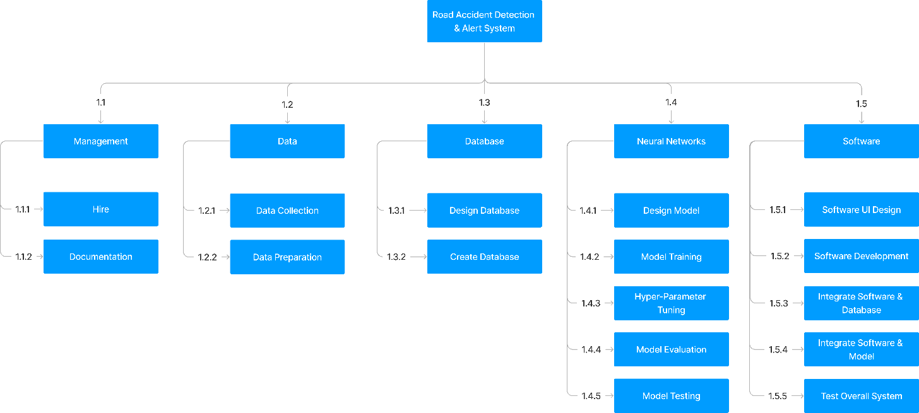
Work Breakdown Structure(WBS)

Slide 17
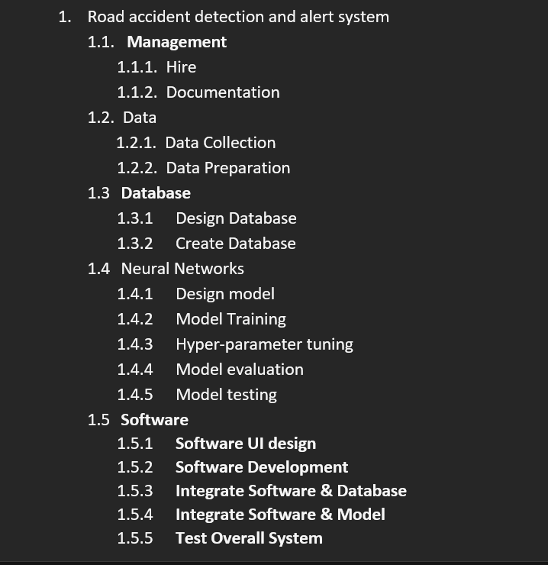
WBS CODING

Slide 18
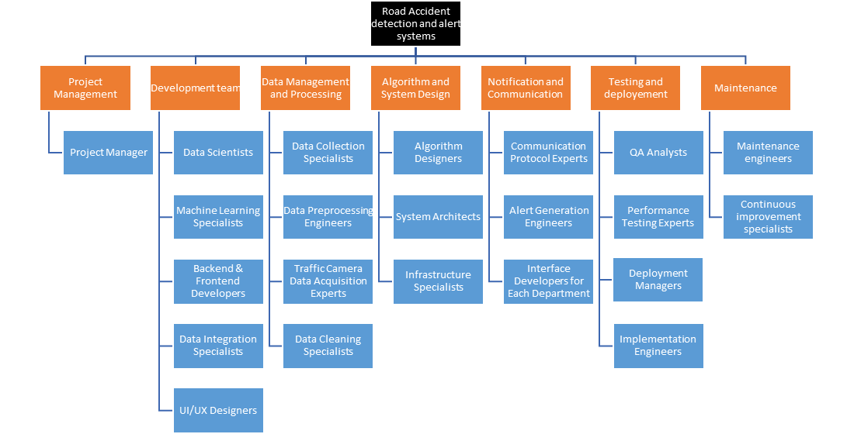
Organizational Breakdown Structure(OBS)

Slide 19
Project schedule with at least 12 activities at least one burst and at least 1 merge activities
Activity | Description | Preceding Activity | Activity Time (Days)
A | Hire | None | 7
B | Data Collection | A | 5
C | Design Model | A | 14
D | Design Database | A | 7
E | Software UI Design | A | 8
F | Data Preparation | B | 3
G | Create Database | D | 14
H | Software Development | E | 28
I | Model Training | C, F | 28
J | Integrate Software & Database | G, H | 5
K | Hyper-parameter tuning | I | 7
L | Model Evaluation | K | 3
M | Model Testing | L | 5
N | Integrate Model& Software | J, M | 5
O | Test Overall System | N | 7

Slide 20
Network diagram & Gantt chart

Slide 21
Network diagram & Gantt chart

Slide 22
Resource usage form
Week | Data Scientists |  | Software Engineers | Hardware Engineers
1 | Collecting and Cleaning Data, Preprocessing Data |  | Developing User Interface | Designing Sensors, Implementing Data Processing Units
2 | Collecting and Cleaning Data, Preprocessing Data |  | Integrating System with Other Systems | Implementing Data Processing Units, Implementing Communication Networks
3 | Developing Algorithms |  | Deploying System to Production | Designing Sensors, Implementing Communication Networks
4 | Developing Algorithms, Training the Neural Network |  | Developing User Interface | Implementing Data Processing Units
5 | Developing Algorithms, Training the Neural Network |  | Integrating System with Other Systems | Implementing Data Processing Units, Implementing Communication Networks
6 | Collecting and Cleaning Data, Preprocessing Data |  | Deploying System to Production | Designing Sensors, Implementing Communication Networks
7 | Collecting and Cleaning Data, Preprocessing Data |  | Developing User Interface | Implementing Data Processing Units
8 | Developing Algorithms, Training the Neural Network |  | Integrating System with Other Systems | Implementing Data Processing Units, Implementing Communication Networks
9 | Collecting and Cleaning Data, Preprocessing Data |  | Deploying System to Production | Designing Sensors, Implementing Communication Networks

Slide 23
Project critical path
A – C – I – K – L – M – N – O
Activities:
A – Hire
C – Design Model
I – Model Training
K – Hyper-parameter Tuning
L – Model Evaluation
M – Model Testing
N – Integrate Model& Software
O – Test Overall System

Slide 24
Risk Assessment form with 6 risk events/conditions
Risk Event | Likelihood (1-5) | Impact (1-5) | Detection Difficulty (1-5) | Timing of Detection
Neural Network Failure | 3 | 4 | 4 | During Operation
Inaccurate Accident Detection | 2 | 3 | 3 | Real-Time
Communication System Failure | 2 | 4 | 3 | Real-Time
Camera Malfunction | 2 | 4 | 2 | Continuous Monitoring
False Positive Alerts | 3 | 3 | 4 | Real-Time
Cybersecurity Threats | 3 | 5 | 4 | Continuous Monitoring

Slide 25
Risk response matrix
Risk Event | Response | Contingency Plan | Trigger | Who Is Responsible
Neural Network Failure | Regularly update and maintain the model | Keep a backup system ready | System Error Alert | AI System Maintenance Team
Inaccurate Accident Detection | Implement redundant detection mechanisms | Manual verification of alerts | Unusual Traffic Pattern | Neural Network Development Team
Communication System Failure | Use multiple communication channels | Establish an alternative communication system | Network Failure Alert | IT and Communication Team
Camera Malfunction | Regular camera maintenance and monitoring | Activate nearby cameras and use other data sources | Camera Offline Alert | Surveillance System Maintenance Team
False Positive Alerts | Fine-tune the neural network parameters. | Introduce a manual verification step | Unusual Activity Alert | Neural Network Development Team
Cybersecurity Threats | Implement robust cybersecurity measures | Regularly update cybersecurity protocols | Suspicious Activity | IT Security Team

Slide 26
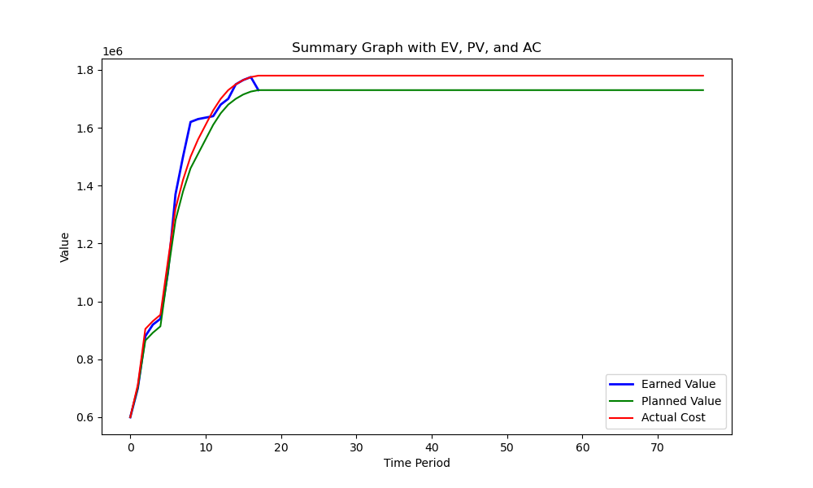
Earned value measure 1/3 of the duration into the project

Slide 27
2 ethic concerns that must be addressed with the project
Privacy – Continuous monitoring could potentially infringe on privacy rights. The system must respect privacy laws and only collect necessary data.
Data Security & Transparency - The system will handle sensitive data, including visual data from accidents. Ensuring the security of this data to prevent misuse or unauthorized access is crucial.

Slide 28
References(4)
Ghosh, Sreyan & Joseph, Sherwin & Roney, Rohan. (2019). Accident Detection Using Convolutional Neural Networks. 1-6. 10.1109/IconDSC.2019.8816881.
Rajesh G, Benny AR, Harikrishnan A, Jacob Abraham J, John NP. (2020). A deep learning based accident detection system In: International conference on communication and signal processing (ICCSP), Chennai, India, pp 1322–1325.
Azhar, A & Rubab, S & Khan, M & Bangash, Y & Alshehri, M & Illahi, F & Bashir, A. (2023). Detection and prediction of traffic accidents using deep learning techniques. Cluster Computing, 26(1), 477-493.
Misbah A & Shanid Malayil & Murshida. K.P & Mohammed Binshad & Mohammed Rizvin K.V & Mishal Kandanath. 2023."Deep Learning-based Auto Accident Detection and Alert System for Vehicles", 2023 International Conference on Innovations in Engineering and Technology (ICIET), pp.1-5.

Slide 29
Thank you

